Slide 1

Discrete-Time Signals and Systems Convolution and Correlation
Wenda Li
EM2.14
wenda.li@hw.ac.uk
Notes:
The DSP LiB is all about discrete-time linear time-invariant systems. Some prior knowledge of continuous-time linear time-invariant systems on the part of students is assumed. This might have been acquired through studying signals and systems theory or engineering mathematics.
That said, the slides in this lecture aim to review the most relevant and important pieces of continuous-time systems theory required.

Slide 2
Discrete-Time Linear Time Invariant System
x(n)
discrete-time
LTI system
y(n)
{time-varying}
{time-varying}
input signal
output signal
Notes:
The block in the diagram represents a system acting on an input signal to produce an output signal. Signals carry information between systems. Both signals and systems may be described in terms of mathematical equations. Often these mathematical equations will appear very similar whether they represent signals or systems. Commonly a system is described in terms of a signal (its impulse response). That signal is involved at the most fundamental level in the diagram shown here (the output signal is formed by convolving the input signal with the system’s impulse response) but does not appear in the diagram explicitly as a signal.
This may all seem obvious but as we progress to study digital signal processing concepts and theory, it will serve us well to have a firm understanding of the concept of a system acting on a signal – as represented here.
The DSP Lab-in-a-Box is concerned with discrete-time signals rather than with continuous-time signals. In the diagram, this is implied by the representation of signals as functions of n. Discrete-time signals are sequences of numbers.
As mentioned already, linear time-invariant systems (LTIs) are described entirely by their impulse responses. If you know the impulse response of an LTI, you know everything there is to know about it. The same may be said of frequency responses and transfer functions. These may be derived from an impulse response (and vice versa). The impulse response of a discrete-time LTI is a sequence (a function of n).

Slide 3
Classification of Signals
Continuous-time vs. discrete-time
Periodic vs. aperiodic
Deterministic vs. random
Energy vs. power
Notes:
The following binary classifications of signals are often used in digital signal processing (and in signals and systems theory).
The first two classifications listed here are of particular relevance to Fourier analysis and the representation of signals and systems in the time and frequency domains.

Slide 4
Continuous-Time vs. Discrete-Time
A continuous -time signal x(t) is defined for all values of time, t
x(t) need not be a continuous function of time, e.g. unit step
A discrete-time signal x(n) = x(nT) is defined only at discrete values of time t=nT.
u(t)
1
the unit step function u(t) is an
example of a continuous-time
signal containing a discontinuity
0
-2
-1
0
1
2
3
t

Slide 5
Converting from Continuous to Discrete Time
A discrete-time signal may be formed by sampling a continuous-time signal
x(nT)
x(t)
x(t)
T
0
kT
(k+1)T
(k+2)T
t
x(t)
nT
x(n)
sampler
quantiser
Notes:
As represented here in the top diagram, the value of a discrete-time sample may be anywhere in the range of x. A widespread use of discrete-time signals is in digital electronic systems and here signals must be quantised so as to belong to a finite set of possible values, e.g. Integer values in the range -32768 to 32767.
Analogue to digital converters typically combine sampling and quantising functions.
The process of quantisation introduces (what may be regarded as) random noise to a signal. This is an important topic in signal processing. However, in these materials we will not consider quantisation noise explicitly. For our purposes we will consider it to have been reduced to negligible levels by the use of a suitably high-resolution analogue to digital converter.

Slide 6
Periodic vs. Aperiodic Signals
A continuous -time signal x(t) is periodic if and only if
The smallest positive value of T for which this is the case is the period of the signal
A discrete-time signal x(n) is periodic if and only if
Any signal that is not periodic is aperiodic.
for all t.
for all n.

Slide 7
Deterministic vs. Random Signals
Deterministic signals are described as algebraic functions of time.
Random (stochastic) signals are described in terms of their statistical properties.
Notes:
We can predict (determine) the value of a deterministic signal at a particular point in time (using an algebraic equation).
We cannot predict the value of a stochastic signal at a particular point in time.

Slide 8
Power vs. Energy Signals
The energy in signal x(t)
The average power in signal x(t)
If x(t) is the current (measured in amps) flowing
in a resistor of value 1 ohm then E is the total
energy (measured in joules) dissipated in that
resistor (over all time) and P is the average
power (measured in watts).
If average power P is finite and non-zero then E will be infinite and x(t) is described
as a power signal.
If E is finite then x(t) is described as an energy signal.

Slide 9
Impulse (Delta or Dirac) Function
For continuous-time systems
For discrete-time systems
Notes:
That’s it for signal classifications.
The following, starting with the delta function, are fundamentally important examples of signals.
Notice that the value of the continuous-time impulse at time t = 0 is undefined. The discrete-time delta function, or Kronecker delta sequence, is altogether easier to get your head around.

Slide 10
Unit Step Function
For continuous-time systems
For discrete-time systems
Notes:
The unit step function is found by integrating (or summing) the unit impulse function.

Slide 11
Sinusoid Function
For continuous-time systems
For discrete-time systems
Sinusoidal signals pass through (any) linear time-invariant system with no change
to their shape.
Notes:
sin(ωt) is one example of a sinusoid. More generally you might want to consider sin(ωt+φ).

Slide 12
Complex Exponential Function
For continuous-time systems
For discrete-time systems
Im
Asin(ωt)
rotating vector
ωt
Acos(ωt)
Re
A
Rotating vector (phasor) in complex plane.
Closely related to sinusoidal signals.
Projections onto real and imaginary axes of complex plane are cosine and sine respectively.
Notes:
Anticlockwise rotation of phasor is associated with positive frequency
We will revisit complex exponentials later, in more detail.
Contra-rotating phasors can combine to form real-valued sinusoidal signals – in other words, real-valued sinusoids may be decomposed into complex exponentials.
These relationships are described by Euler’s formula.

Slide 13
Euler’s Formula
Notes:
Euler’s formula describes the relationship between complex exponentials and real-valued sinusoids.

Slide 14
Impulse Response and Linear Systems
A linear time invariant system is characterised by its impulse response h(t) or h(n).
Its output y(t) is formed by convolution of input signal x(t) and system impulse
Response h(t).
Notes:
The convolution integral and convolution sum as presented here are of fundamental importance to linear systems theory since the convolution sum describes what is going on in the block diagram in the first slide. The it presents the relationship between input signal x(t), system impulse response h(t), and output signal y(t).

Slide 15
Sampling and Reconstruction
Can we recreate from discrete-time samples the continuous-time signal from which they were taken?
Notes:
The analogue to digital converter mentioned earlier is one part of a digital signal processing system (typically in engineering it is implied that we wish to apply DSP to continuous-time, physical, analogue quantities)
After processing, discrete-time signals are converted back into continuous-time signals using a digital to analogue converter (DAC).
In an electrical engineering sense, the role of the DAC is to convert sample values represented with digital electronic hardware into a continuous analogue voltage waveform.
In signal processing terms, the role of the DAC is to ‘join the dots’ or interpolate between discrete-time sample values.
Can we recreate from discrete-time samples the continuous-time signal from which they were taken?

Slide 16
Digital to Analogue Conversion Using a Zero-Order Hold
A zero-order hold (ZOH) has the following impulse response
1
T is the sampling period
0
T
t
y(nT)
h(t)
y(t) = y(nT) * h(t)
t
t
t
T
digital to analogue conversion using a zero-order hold
Notes:
Convolution of the ZOH impulse response with the sampled signal y(n) results in a continuous-time signal y(t).

Slide 17
Discrete Time Convolution
An arbitrary input signal y(n) may be decomposed into a sum of (delayed)
weighted impulses.
Corresponding output is formed by summing (delayed) weighted impulse responses.
d(n)
h(n)
d(n)
LTI
system
y(n)
-1
0
1
2
3
n
-1
0
1
2
3
n
Delta sequence
Impulse response

Slide 18
Convolution
Consider convolution from the point of view of the input signal
Each weighted impulse at the system input results in a weighted impulse response
at the system output.
Each input sample contributes to a number of output sample values.

Slide 19
Convolution
output signal y(n) comprises
sum of responses
response to x(0)
n
0
n
0
1
2
5
1
2
3
4
5
3
4
x(n)
response to x(1)
x(n)
LTI
system
y(n)
n
5
n
4
5
0
4
0
1
2
1
2
3
n
3
0
1
2
3
4
h(n)
response to x(2)
arbitrary input signal (sequence)
n
n
0
4
5
n
0
1
2
1
2
3
-1
0
1
2
3
3
impulse response
response to x(3)
n
0
n
0
1
2
4
5
1
2
3
4
5
3
Notes:
Overall system output y(n) is found by summing the responses to each individual input sample.

Slide 20
Convolution
A more practical and useful approach is to consider convolution from the point of
view of the output signal
Each output sample value can be computed based on a number of input
sample values
If impulse response is finite

Slide 21
Convolution
Convolution is a fundamental and important building block in digital signal
processing.
Its implementation is a sum of products.
Single cycle MAC and Harvard architecture are suited to its efficient computation.
Notes:
Conceptually, FIR filters implement convolution (of input signal and filter coefficients). However, the convolution sum of products is computationally expensive for a large numbers of filter coefficients. A more computationally efficient method of implementing large FIR filters is to transform signals into the frequency domain and carry out the filtering operation there before transforming the result back into the time domain. In other words, FIR filters may not necessarily be implemented using a sum of products computation.

Slide 22
Properties of Convolution
Convolution involving the delta sequence is particularly straightforward
Commutative property
Associative property
Distributive property
Notes:
The convolution of ‘something’ with a delta function is ‘something’.
The convolution of ‘something’ with a delayed delta function is a delayed ‘something’.
The convolution of ‘something’ with a weighted delta function is a weighted ‘something’.

Slide 23
Correlation
Correlation is concerned with determining the degree of similarity between
two signals
Computationally it bears a resemblance to convolution

Slide 24
Correlation
Sum of products
At the heart of the discrete Fourier transform (DFT)
Notes:
Earlier it was mentioned that, in practice, FIR filters might be implemented in the frequency domain, rather than by convolution (sum of products) in the time domain.
However, the DFT is computed by correlating (sum of products) a sequence of samples with a (finite) number of sequences representing individual frequency components.
Did I mention that sum of products is a fundamental operation in DSP?

Slide 25
Correlation vs. Convolution
The similarities between the computations involved in convolution and correlation
are coincidental.
Convolution describes the relationships between input signal, output signal and
impulse response in a LTI system.
Correlation is a method of determining the degree of similarity between two signals.

Slide 26
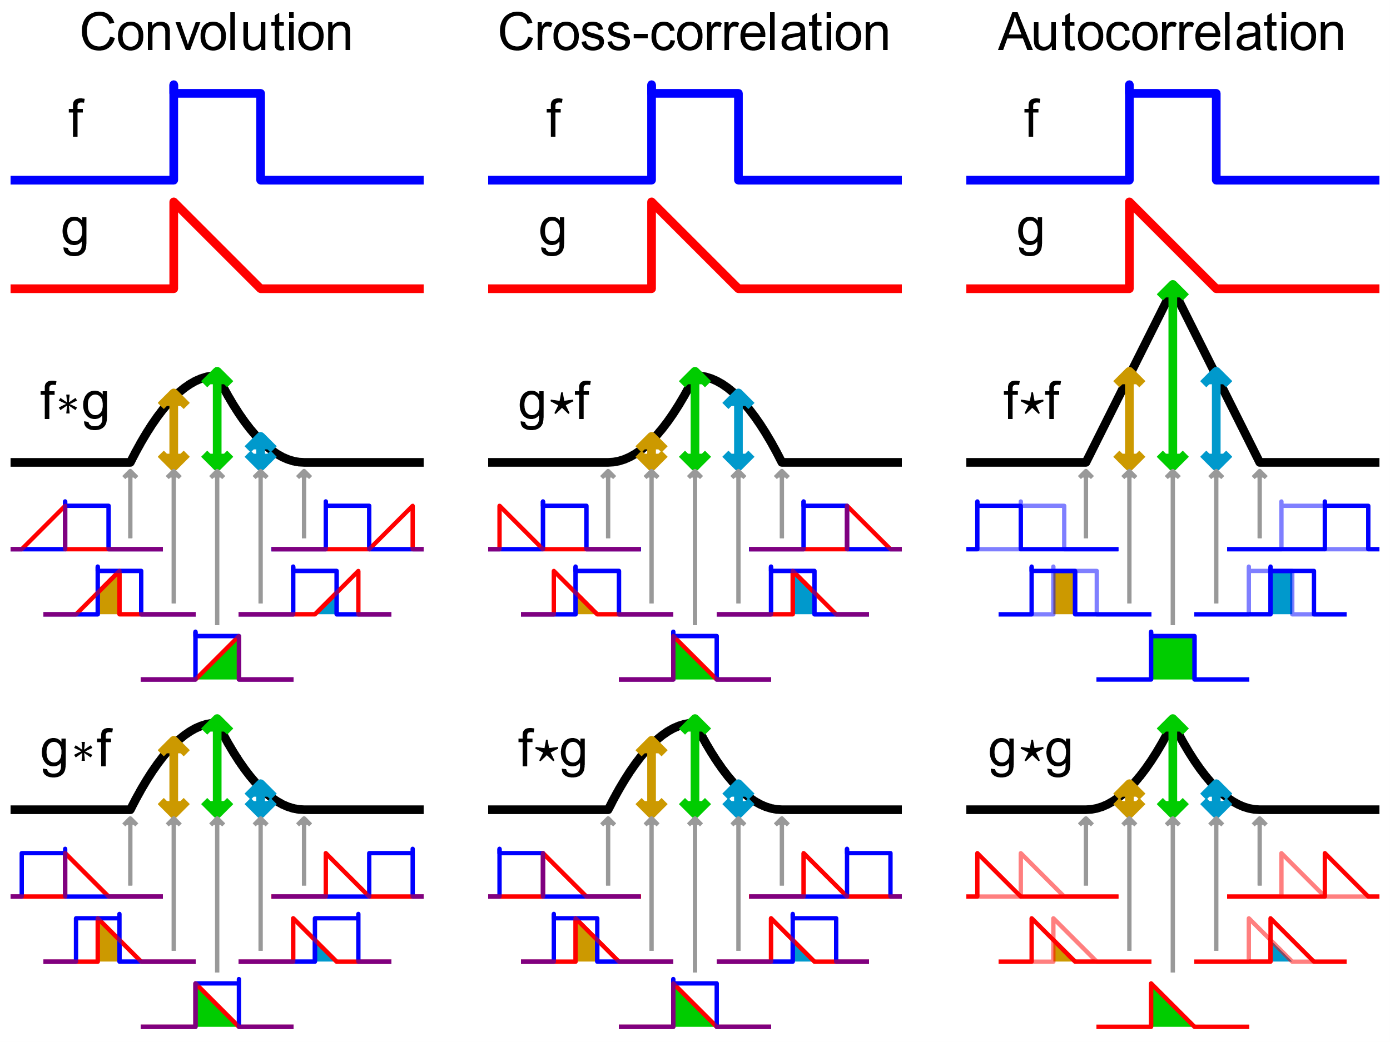
Correlation vs. Convolution
https://en.wikipedia.org/wiki/Convolution

